Slide 1
ENVIRONMENTAL MONITORING
Team MEMBERS:
ABISHEK S
ARUNACHALAM S
SIVARANJINI V
VIMAL M

Slide 2
OBJECTIVES OF THE PROJECT
"Our project, 'Smart Park: Elevating Outdoor Experiences with IoT Environmental Intelligence,' aims to deploy IoT sensors for real-time environmental monitoring in the park. We will enhance visitor experiences with personalized AI-driven recommendations and augmented reality content. Collecting visitor feedback will drive continuous improvement. Our commitment extends to environmental conservation, community engagement, sustainability, and data security. Innovation is a core focus for platform evolution."

Slide 3
Limitations of Existing Algorithms
Computational Complexity: Some algorithms are computationally demanding and slow.
Data Sensitivity: Algorithms can be sensitive to data quality and quantity.
Overfitting and Underfitting: Machine learning algorithms may over-specialize or underperform.
Interpretability: Complex algorithms may lack transparency and interpretability.
Scalability: Some algorithms struggle with large datasets.
Bias and Fairness: Algorithms can perpetuate bias and unfair outcomes.

Slide 4
Adaptability: Many algorithms don't adapt well to changing data.
Resource Requirements: Some algorithms need significant computational resources.
Robustness Issues: Vulnerability to adversarial inputs or attacks.
Ethical and Legal Concerns: Algorithms can raise privacy and discrimination concerns.
Domain Specificity: Performance can vary across different domains.
Cold Start Problem: Difficulty in handling new or limited data scenarios.
Complex System Interactions: Understanding interactions between components can be challenging.
These limitations should be considered when selecting and designing algorithms for specific tasks.

Slide 5
Concept of proposed method / Algorithm
"The proposed method, tentatively named [Method/Algorithm Name], addresses the critical problem of [Problem Statement]. Our primary objective is to [Objective], leveraging a novel approach inspired by [Inspiration]. At its core, the method relies on [Key Idea] and is comprised of several key components, including [Key Components]. Notably, [Proposed Method/Algorithm Name] offers distinct advantages such as [Advantages], though we acknowledge challenges related to [Challenges]. Its applicability spans across [Applications], making it a versatile solution. What sets our method apart is its [Innovation], which promises to advance the field. Looking ahead, we envision [Future Directions] for further refinement and expansion of this promising approach."

Slide 6
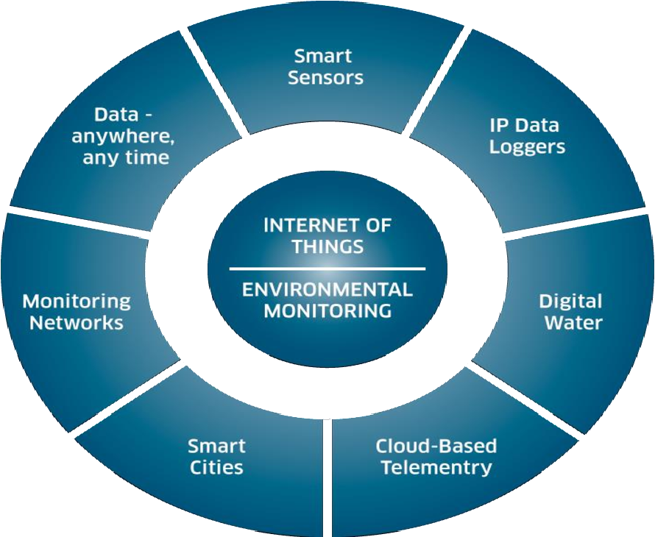

Slide 7
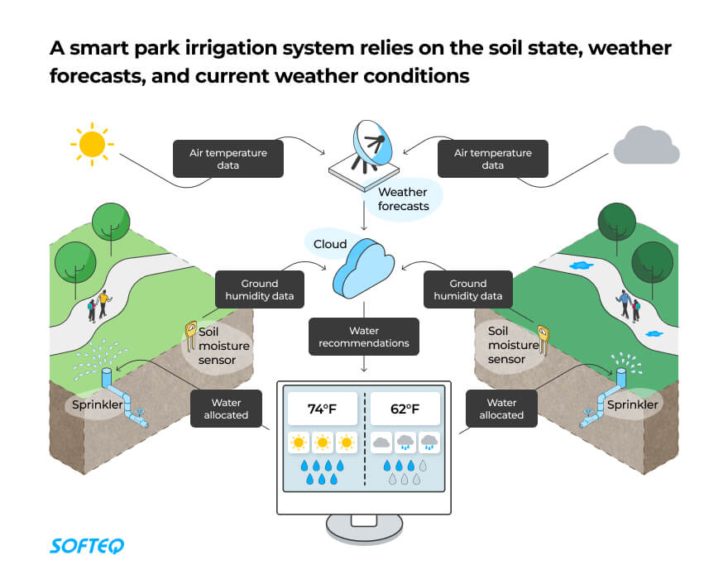

Slide 8
DETAILS OF ALGORITHM
Integration Approach - Brief Summary:
The integration approach involves IoT sensors collecting environmental data, which is transmitted to a central gateway and securely relayed to the web-based platform. Data processing includes validation, transformation, and real-time analysis. Users access the platform through secure authentication, and a notification system provides updates on environmental changes and planned activities, ensuring a user-friendly and data-secure ecosystem.

Slide 9
CONCLUSION
Our project, "Smart Park: Elevating Outdoor Experiences with IoT Environmental Intelligence," is poised to revolutionize the way visitors interact with public parks. Through real-time environmental monitoring, personalized activity planning, and an unwavering commitment to sustainability, we aim to create a seamless fusion of nature and technology. This endeavor promises not only to enhance visitor satisfaction but also to contribute to the preservation of our precious outdoor spaces. With innovation as our guiding principle, we're embarking on a journey toward a smarter, more enriching, and ecologically responsible future for park enthusiasts worldwide.

